Slide 1

Microsoft Azure Speech Services
By Mohit Mande

Slide 2

Introduction
Azure Speech Services is a cloud-based suite of APIs and SDKs designed to enable powerful speech-related capabilities in applications.
From speech-to-text transcription to text-to-speech synthesis, Azure Speech Services provides a comprehensive set of tools for voice-enabled applications.

Slide 3

Key Features
Speech-to-Text (STT):
Convert spoken language into written text.
Ideal for transcription services, voice assistants, and more.
Text-to-Speech (TTS):
Convert written text into lifelike spoken language.
Enhance applications with natural-sounding voices for better user experiences.
Speech Translation:
Translate spoken language in real-time, enabling multilingual communication.
Speaker Recognition:
Identify and verify speakers based on unique voice characteristics.

Slide 4
Speech to Text Conversion
Azure Speech Services
Azure Speech Services provides a powerful speech to text conversion feature that allows users to convert spoken language into written text.
Transcription Services
Voice Assistants
The speech to text conversion capability of Azure Speech Services is particularly useful in transcription services, where it can automatically transcribe spoken content into written text.
Speech to text conversion is also a key component of voice assistants, allowing them to understand and respond to spoken commands or queries.

Slide 5

Technologies used in Speech to text Services:
Language Modeling
Hidden Markov Models (HMMs)
Deep Neural Networks
Convolutional Neural Networks
Recurrent Neural Networks

Slide 6
Methodolgies used
Import Modules
Set Subscription Key and Region
Create Speech Configuration
Configure Audio Input
Initialize Speech Recognizer
Recognize Speech
Handle Recognition Results
Display Results

Slide 7
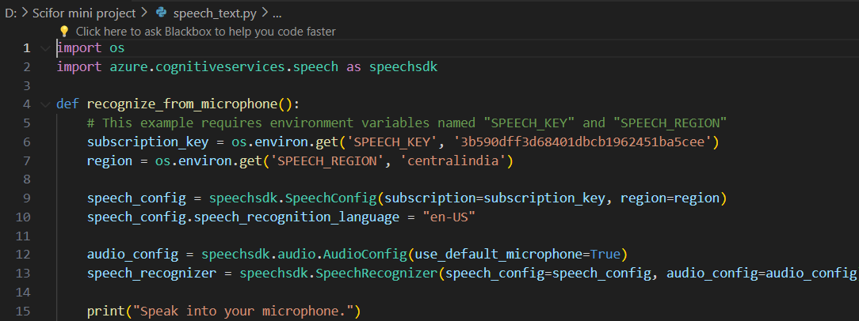
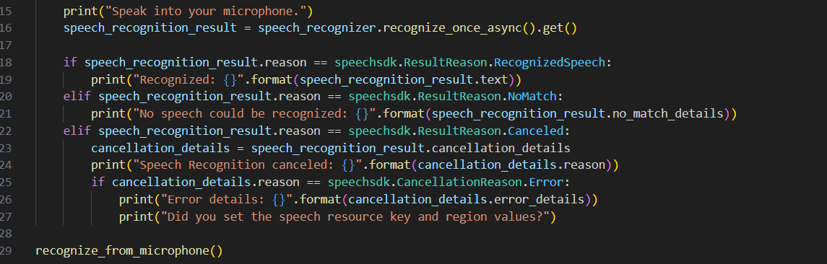
Code

Slide 8
THANK YOU ☺

